Slide 1
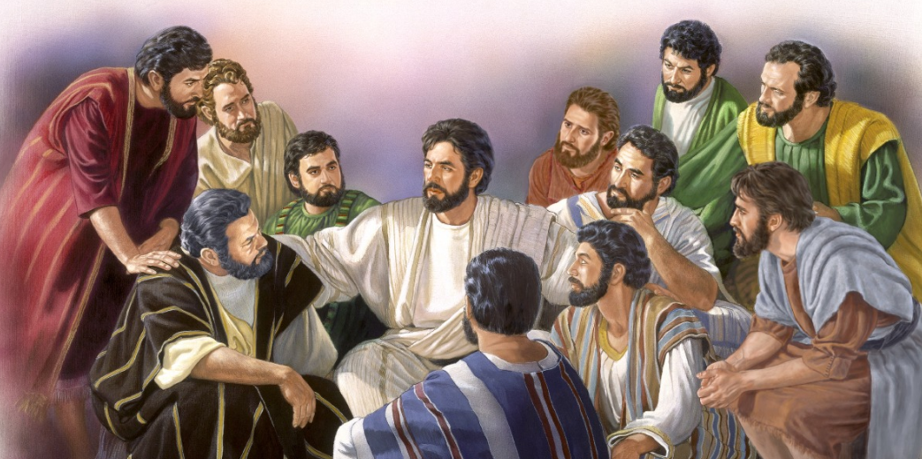
John 14:1
John 14:27
Let Not Your Heart Be Troubled
The Comfort of a Complete Faith
The Hope of a Prepared Place
The Promise of a Second Coming
The Assurance of Answered Prayer
The Meaning of Disciple’s Love
The Gift of God’s Peace

Slide 2
Soon Met Challenges to Trouble Their Hearts
At his arrest & trial:
  Judas “stood with them” (John 18:5)
  Peter “followed at a distance” (Matt. 26:58; Jno. 18:16)
  Peter “stood with them” (John 18:18)
Upon his death:
  Wondering where laid him (John 19:2)
  Weeping (John 19:11)
When he ascended
  Stand gazing into heaven (Acts 1:11)
  Band together and pray (Acts 1:14)

Slide 3
Sudden Success and then a Collision
On Pentecost (Acts 2)
  Large crowd heard them speak (v. 5)
  3,000 obeyed the gospel (v. 41)
A Collision (Acts 4 -5)
  Peter & John were arrested
  Brought before the counsel
  Threatened
  Beaten

Slide 4
Apostles & Early Disciples Were Courageous
Acts 4
Peter and John Before the Council
Peter and John Questioned by the Council (vv. 1-22)
  Arrested (vv. 1-4)
  Questioned (vv. 5-12)
  Reaction of the council (vv. 13-22)
The Reaction of the Disciples (vv. 23-31)
  Peter and John report to the disciples (v. 23)
  The disciples’ prayer for boldness (vv. 24-30)
  The results of prayer (v. 31)
The Commitment of the Disciples (vv. 32-37)
  To unity (v. 32a)
  To one another (vv. 32b, 34-37)
  To the proclamation of the gospel (v. 33)

Slide 5
Always Has Been A Need For Courage
Joshua 1
6 Be strong and of good courage, for to this people you shall divide as an inheritance the land which I swore to their fathers to give them.
9 Have I not commanded you? Be strong and of good courage; do not be afraid, nor be dismayed, for the LORD your God is with you wherever you go."
18 Whoever rebels against your command and does not heed your words, in all that you command him, shall be put to death. Only be strong and of good courage."

Slide 6

Courage Defined
“The quality of mind or spirit that enables a person to face difficulty, danger, pain, etc,. without fear; bravery.”
- Dictionary.com

Slide 7

Courage Is Standing Alone in the Crowd

Slide 8
Acts 4
Courageous
Living

Slide 9
Acts 4
Courageous Living
Giving Answers to Opportune Questions (v. 7)

Slide 10
Giving Answers to Opportune Questions (v. 7)
Great question with great opportunity
  Not all questions provide opportunity to teach the truth
  Q – Who authorized this?
    Opportunity to talk about Jesus (vv. 8-12)
    Opportunity to talk about authority (vv. 12, 19)
Courageous Living

Slide 11
Giving Answers to Opportune Questions (v. 7)
Great question with great opportunity
Takes courage to give such an answer
  It took courage for Peter & John (vv. 8-12)
  Answer will be narrow
  Answer will be contrary to what people believe
  Answer you give may be thought strange
Courageous Living

Slide 12
Giving Answers to Opportune Questions (v. 7)
Great question with great opportunity
Takes courage to give such an answer
Questions may provide opportunity
  To teach about authority (cf. Acts 15)
  To teach about Christ & his resurrection (Rom. 1:4)
  To teach that it makes a difference (2 Thess. 2:10-12)
Courageous Living

Slide 13
Giving Answers to Opportune Questions (v. 7)
Great question with great opportunity
Takes courage to give such an answer
Questions may provide opportunity
Answers require knowing how to answer
  Know what to say (1 Pet. 3:15)
  Know how to say it (2 Tim. 2:2; cf. Matt. 10:19)
Courageous Living

Slide 14
Giving Answers to Opportune Questions (v. 7)
Are You
Living Courageously?
Giving Answers to Opportune Questions?
Courageous Living

Slide 15
Acts 4
Courageous Living
Giving Answers to Opportune Questions (v. 7)
Trusting in the One Way (v. 12)

Slide 16
Trusting in the One Way (v. 12)
No other way to be saved – but through Christ
  He is THE way (John 14:6)
  Any who are saved – will be saved His way
  Name = all a person is and all their attributes / authority
  Every tree not planted by Lord – rooted up (Matt. 15:13)
Courageous Living

Slide 17
Trusting in the One Way (v. 12)
No other way to be saved – but through Christ
Trusting the one way – takes courage:
  To state there is only one way (Eph. 4:4-6)
  To trust the one way – with all life and soul
  When world has no time for a religion that thinks they are right – teaches such a limited view
  To tell those who trust that they are saved – that need salvation
Courageous Living

Slide 18
Trusting in the One Way (v. 12)
Are You
Living Courageously?
Putting Your Trust in the One Way?
Courageous Living

Slide 19
Acts 4
Courageous Living
Giving Answers to Opportune Questions (v. 7)
Trusting in the One Way (v. 12)
Showing Evidence of the Influence of Jesus (v. 13)

Slide 20
Showing Evidence of the Influence of Jesus (v. 13)
What the people saw
  Boldness (confident – without fear or timidity)
  Uneducated – (unschooled NIV) - not formally trained
  Untrained – (ordinary NIV; common RSV) men
Courageous Living

Slide 21
Showing Evidence of the Influence of Jesus (v. 13)
What the people saw
What they concluded
  These men had been with Jesus
  “realized what being with Jesus had done for them!” (TLB)
  They had same boldness – same message
Courageous Living

Slide 22
Showing Evidence of the Influence of Jesus (v. 13)
What the people saw
What they concluded
Takes courage to let the influence of Jesus show
  Priorities (Matt. 6:33)
  Treat others fairly (Matt. 7:12)
  Home roles (1 Pet. 3:1-7)
  Saying no to some things (1 Pet. 4:4)
Courageous Living

Slide 23
Showing Evidence of the Influence of Jesus (v. 13)
Are You
Living Courageously?
Showing Others That You
Have Been With Jesus?
Courageous Living

Slide 24
Acts 4
Courageous Living
Giving Answers to Opportune Questions (v. 7)
Trusting in the One Way (v. 12)
Showing Evidence of the Influence of Jesus (v. 13)
Having Unstoppable Determination (v. 20)

Slide 25
Having Unstoppable Determination (v. 20)
Given an ultimatum
  Obey the Sanhedrin - Don’t teach any more
  Don’t obey God!
  Forbade them to speak in the name of Jesus
  Apostles appealed to the conscience of rulers – as to whose authority should obey (v. 19)
Courageous Living

Slide 26
Having Unstoppable Determination (v. 20)
Given an ultimatum
Determined to speak – could not be stopped
  Absolutely convinced the message was true!
  Felt compelled to do right – no matter what
  Tell the truth – even if it is opposed
    Tell whole counsel (Acts 20:26-27)
    Whether they will listen or not (Ezek. 3:17-19; 2 Tim. 4:2-5)
Courageous Living

Slide 27
Having Unstoppable Determination (v. 20)
Given an ultimatum
Determined to speak – could not be stopped
Determine to do right – live for God – cannot be stopped
  Virtue – Moral courage (2 Pet. 1:5)
  Paul could not be stopped (Acts 14:19-21)
  Need the attitude: No one is going to stop me from doing what is right!
  When can be easily stopped (by family or other plans) – not courageous
Courageous Living

Slide 28
Having Unstoppable Determination (v. 20)
Are You
Living Courageously?
Have a determination that cannot be stopped?
Courageous Living

Slide 29
Acts 4
Courageous Living
Giving Answers to Opportune Questions (v. 7)
Trusting in the One Way (v. 12)
Showing Evidence of the Influence of Jesus (v. 13)
Having Unstoppable Determination (v. 20)
Praying in Earnest (vv. 24-30)

Slide 30
Their Prayer
24 So when they heard that, they raised their voice to God with one accord and said: "Lord, You are God, who made heaven and earth and the sea, and all that is in them,
25 who by the mouth of Your servant David have said: 'Why did the nations rage, And the people plot vain things?
26 The kings of the earth took their stand, And the rulers were gathered together Against the LORD and against His Christ.'
27 "For truly against Your holy Servant Jesus, whom You anointed, both Herod and Pontius Pilate, with the Gentiles and the people of Israel, were gathered together
28 to do whatever Your hand and Your purpose determined before to be done.
29 Now, Lord, look on their threats, and grant to Your servants that with all boldness they may speak Your word,
30 by stretching out Your hand to heal, and that signs and wonders may be done through the name of Your holy Servant Jesus."

Slide 31
Praying in Earnest (vv. 24-30)
Praise (v. 24)
Recognized God is in control (v. 24)
Problem at hand (vv. 25-28)
For boldness (vv. 29-30)
Courageous Living

Slide 32
Praying in Earnest (vv. 24-30)
Are You
Living Courageously?
Praying Earnestly?
Courageous Living

Slide 33
Acts 4
Courageous Living
Giving Answers to Opportune Questions (v. 7)
Trusting in the One Way (v. 12)
Showing Evidence of the Influence of Jesus (v. 13)
Having Unstoppable Determination (v. 20)
Praying in Earnest (vv. 24-30)
Being an Encouragement (v. 36)

Slide 34
Being an Encouragement (v. 36)
Such an encouragement – named Barnabas
  Barnabas means “son of encouragement”
  When one possessed so much of a quality – often called the “son of” that quality (i.e. Eph. 2:2)
Courageous Living

Slide 35
Being an Encouragement (v. 36)
Such an encouragement – named Barnabas
Barnabas was encouraging to others
  Vouched for Paul (Acts 9:26-28)
  Strengthened the church at Antioch (Acts 11:22-24)
  Traveled & helped Paul (Acts 13-14)
  Didn’t give up – but saw potential (Acts 15)
Courageous Living

Slide 36
Being an Encouragement (v. 36)
Such an encouragement – named Barnabas
Barnabas was encouraging to others
You can encourage
  With word of God (1 Thess. 4:18)
  With your presence & faithfulness (Heb. 10:24)
  With commendation (Phil. 2:19-20)
  With confidence (Heb. 6:9)
Courageous Living

Slide 37
Being an Encouragement (v. 36)
Are You
Living Courageously?
Are You An Encouragement to Others?
Courageous Living

Slide 38
Acts 4
Courageous Living
Giving Answers to Opportune Questions (v. 7)
Trusting in the One Way (v. 12)
Showing Evidence of the Influence of Jesus (v. 13)
Having Unstoppable Determination (v. 20)
Praying in Earnest (vv. 24-30)
Being an Encouragement (v. 36)

