Slide 1

My Servants The Prophets
A Study of the Major Prophets
Isaiah
Lesson 4
Chapters 49-66

Slide 2
Outline of Isaiah
Judgment from God - Assyrian Period: Conflict and Victory (1-39)
  Prophecy against Judah and Jerusalem (1-12)
  Prophecy against the nations (13-23)
  World judgment and deliverance of God’s people (24-27)
  Woes against the sins of the people (28-35)
  Historical interlude concerning Hezekiah (36-39)
    Victory over Assyria (36-37)
    His sin with Babylon (38-39)
Comfort from God - Hope for Troublesome Times - The Remnant Returns (40-66)
  Deliverance from Babylonian captivity (40-48)
  Suffering servant (49-57)
  Future glory (58-66)
Adapted from Homer Hailey, Warren Weirsbe and others

Slide 3
Isaiah
Chapters 49-66

Slide 4

The Point of this Section
Promise of return from Babylon
Messiah – bright future

Slide 5
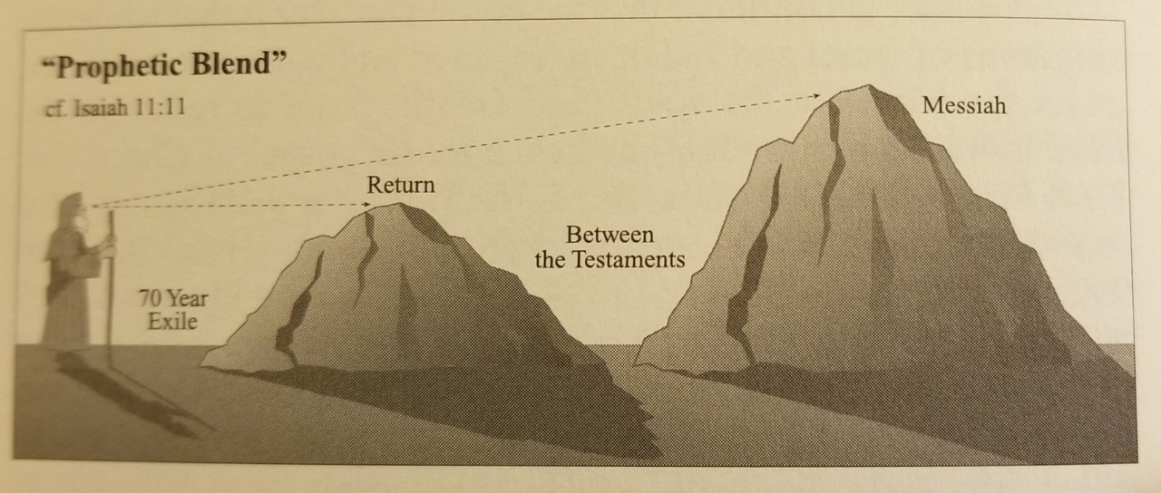
John A. Humphries, Jeremiah and Lamentations, 26

Slide 6
Deliverance from Babylonian Captivity (40-48)
Suffering Servant (49-57)
  The work of Jehovah’s servant – the Messiah (49)
    The servant is sent to all, but all will not listen (vv. 1-6)
    Blessings under the messiah (vv. 7-13)
    God has not forgotten Zion (vv. 14-26)

Slide 7
Deliverance from Babylonian Captivity (40-48)
Suffering Servant (49-57)
  The work of Jehovah’s servant – the Messiah (49)
  Israel is told to trust and follow the Lord (50-51)
    Trust in the Lord who is faithful (50)
      What reason did Israel have to question God (vv. 1-3)?
      The Lord will help his servant (vv. 4-9)
      A call to obey the Servant (vv. 10-11)
    Exhortation to listen (51)
      Three reasons to listen to God (vv. 1-8)
      A call upon god to defend his people (vv. 9-16)
      A call to Jerusalem to listen (vv. 17-23)

Slide 8
Deliverance from Babylonian Captivity (40-48)
Suffering Servant (49-57)
  The work of Jehovah’s servant – the Messiah (49)
  Israel is told to trust and follow the Lord (50-51)
  Deliverance and a suffering servant (52)
    Deliverance from captivity (vv. 1-12)
      Zion instructed to put on beautiful garments for they are free from bondage (vv. 1-2)
      The Lord will redeem Zion (vv. 3-6)
      The message of deliverance proclaimed (vv. 7-12)
    The suffering servant (vv. 13-15)
      He will be exalted (v. 13)
      He will be treated shamefully (v. 14)
      He will startle the nations (v. 15)

Slide 9
Deliverance from Babylonian Captivity (40-48)
Suffering Servant (49-57)
  The work of Jehovah’s servant – the Messiah (49)
  Israel is told to trust and follow the Lord (50-51)
  Deliverance and a suffering servant (52)
  Victory through the suffering servant (53)
    Rejected of men (vv. 1-3)
    The reason for his suffering: sinful man (vv. 4-6)
    Total submission to suffering (vv. 7-9)
    Victory and reward (vv. 10-12)

Slide 10
Deliverance from Babylonian Captivity (40-48)
Suffering Servant (49-57)
  The work of Jehovah’s servant – the Messiah (49)
  Israel is told to trust and follow the Lord (50-51)
  Deliverance and a suffering servant (52)
  Victory through the suffering servant (53)
  God will bless Zion (54)
    Zion will be enlarged (vv. 1-3)
    Zion will forget the same of her past (vv. 4-8)
    God has a covenant of peace with his people (vv. 9-10)
    Zion will have glory, strength, and protection (vv. 11-17)

Slide 11
Deliverance from Babylonian Captivity (40-48)
Suffering Servant (49-57)
  The work of Jehovah’s servant – the Messiah (49)
  Israel is told to trust and follow the Lord (50-51)
  Deliverance and a suffering servant (52)
  Victory through the suffering servant (53)
  God will bless Zion (54)
  The great invitation for all to come (55)
    Free without a price (vv. 1-3)
    Offered to all (vv. 3b-5)
    Seek it while you can (v. 6)
    Repentance (v. 7a)
    Abundant (vv. 7b-11)
    By the word (vv. 10-11)
    Release and joy (vv. 12-13)

Slide 12
Deliverance from Babylonian Captivity (40-48)
Suffering Servant (49-57)
  The work of Jehovah’s servant – the Messiah (49)
  Israel is told to trust and follow the Lord (50-51)
  Deliverance and a suffering servant (52)
  Victory through the suffering servant (53)
  God will bless Zion (54)
  The great invitation for all to come (55)
  Faithful servants in contrast to unfaithful leaders (56)
    Those who serve the Lord will come to the Holy Mountain (vv. 1-8)
    Rebuke of Israel’s leaders (9-12)

Slide 13
Deliverance from Babylonian Captivity (40-48)
Suffering Servant (49-57)
  The work of Jehovah’s servant – the Messiah (49)
  Israel is told to trust and follow the Lord (50-51)
  Deliverance and a suffering servant (52)
  Victory through the suffering servant (53)
  God will bless Zion (54)
  The great invitation for all to come (55)
  Faithful servants in contrast to unfaithful leaders (56)
  The failure of idolatry vs a contrite heart (57)
    The failure of idolatry (vv. 1-13)
    The humble and contrite will be blessed (vv. 14-21)

Slide 14
Deliverance from Babylonian Captivity (40-48)
Suffering Servant (49-57)
Future Glory (58-66)
  Formalism versus true service (58)
    The failure of formalism (vv.1-5)
    True service to the Lord (vv. 6-14)

Slide 15
Deliverance from Babylonian Captivity (40-48)
Suffering Servant (49-57)
Future Glory (58-66)
  Formalism versus true service (58)
  Sin separates from God (59)
    Israel’s sin separated them from God (vv. 1-8)
    Israel’s confession of their sins (vv. 9-15a)
    A redeemer will come to Zion (vv. 15b-21)

Slide 16
Deliverance from Babylonian Captivity (40-48)
Suffering Servant (49-57)
Future Glory (58-66)
  Formalism versus true service (58)
  Sin separates from God (59)
  The glory of future Zion (60)
    The glory of the Lord will be the light (vv. 1-3)
    Zion will be rebuilt with multitudes and wealth (vv. 4-18)
    God will be their glory (vv. 19-22)

Slide 17
Deliverance from Babylonian Captivity (40-48)
Suffering Servant (49-57)
Future Glory (58-66)
  Formalism versus true service (58)
  Sin separates from God (59)
  The glory of future Zion (60)
  The redeemer’s work (61)
    To proclaim salvation (vv. 1-3)
    The result of the message proclaimed (vv. 4-11)

Slide 18
Deliverance from Babylonian Captivity (40-48)
Suffering Servant (49-57)
Future Glory (58-66)
  Formalism versus true service (58)
  Sin separates from God (59)
  The glory of future Zion (60)
  The redeemer’s work (61)
  Promises and assurances to Zion (62)
    God will not rest until he brings salvation to Zion (vv. 1-5)
    God’s protection for Zion (vv. 6-9)
    Proclamation to get ready for salvation is coming (vv. 10-12)

Slide 19
Deliverance from Babylonian Captivity (40-48)
Suffering Servant (49-57)
Future Glory (58-66)
  Formalism versus true service (58)
  Sin separates from God (59)
  The glory of future Zion (60)
  The redeemer’s work (61)
  Promises and assurances to Zion (62)
  God’s lovingkindness (63:1-14)
    God’s lovingkindness means he will punish enemy nations (vv. 1-6)
    God’s lovingkindness remembered (vv. 7-14)

Slide 20
Deliverance from Babylonian Captivity (40-48)
Suffering Servant (49-57)
Future Glory (58-66)
  Formalism versus true service (58)
  Sin separates from God (59)
  The glory of future Zion (60)
  The redeemer’s work (61)
  Promises and assurances to Zion (62)
  God’s lovingkindness (63:1-14)
  Israel’s prayer and the Lord’s answer (63:15 – 65:25)
    A plea for mercy (63:15 – 64:4)
    Confession of sin (64:5-12)
    The Lord’s answer (65)
      Will accept those who obey & reject those who disobey (vv.1-7)
      A remnant will be spared, and the rest destroyed (vv. 8-16)
      A promise of a new heaven and new earth (vv. 17-25)

Slide 21
Deliverance from Babylonian Captivity (40-48)
Suffering Servant (49-57)
Future Glory (58-66)
  Formalism versus true service (58)
  Sin separates from God (59)
  The glory of future Zion (60)
  The redeemer’s work (61)
  Promises and assurances to Zion (62)
  God’s lovingkindness (63:1-14)
  Israel’s prayer and the Lord’s answer (63:15 – 65:25)
  Final rebuke and promise(66)
    A contrast: Lord blesses one who trembles at his word and punishes one who does not (vv. 1-6)
    Blessings and glory in the new Zion (vv. 7-14)
    God’s anger and fury against idolatry (vv. 15-17)
    The glory of God seen by the world (vv. 18-24)

Slide 22
Lessons Learned
Isaiah
Chapters 49-66
God keeps his promises
Put trust and confidence in God
Blessings of living in the day of Messiah
God blesses the obedient & punishes disobedient
Promise of a remnant

