Slide 1
Israel of old was served by a body of men who claimed to speak for God – who were called “Prophets”
God called them, “My servants, the prophets”
2 Kings 9:7; 17:13
Jer. 7:25; 26:25; 29:9; 35:15; 44:4
Ezek. 28:17
Zech 1:6

Slide 2
Moses Spoke of the Greatest Prophet of all
Deut 18:15-22
15 "The LORD your God will raise up for you a Prophet like me from your midst, from your brethren. Him you shall hear,
16 according to all you desired of the LORD your God in Horeb in the day of the assembly, saying, 'Let me not hear again the voice of the LORD my God, nor let me see this great fire anymore, lest I die.'
17 And the LORD said to me: 'What they have spoken is good.
18 I will raise up for them a Prophet like you from among their brethren, and will put My words in His mouth, and He shall speak to them all that I command Him.

Slide 3
Moses Spoke of the Greatest Prophet of all
Deut 18:15-22
19 And it shall be that whoever will not hear My words, which He speaks in My name, I will require it of him.
20 But the prophet who presumes to speak a word in My name, which I have not commanded him to speak, or who speaks in the name of other gods, that prophet shall die.'
21 And if you say in your heart, 'How shall we know the word which the LORD has not spoken?'--
22 when a prophet speaks in the name of the LORD, if the thing does not happen or come to pass, that is the thing which the LORD has not spoken; the prophet has spoken it presumptuously; you shall not be afraid of him.

Slide 4
Deuteronomy 18:15-22
God puts the words into his mouth (v. 18)
Reject the prophet is to reject God (v. 19)
False prophet (vv. 20-22)
Standard by which view all prophets

Slide 5
Studying The Prophets Can Be Confusing
When did he prophecy?
To whom did he prophecy?
Who were his contemporaries?
Where did he prophecy?
How does he fit into the story of the Kings of Israel & Judah?

Slide 6
My Servants
The Prophets

Slide 7
My Servants
The Prophets
Terms Used for the Prophets

Slide 8
Terms Used for the Prophets
Prophet: (Nabhi #5030)
  A spokesman – mouth for God (Exo. 4:16; 7:1)
Exo. 4:16
So he shall be your spokesman to the people. And he himself shall be as a mouth for you, and you shall be to him as God.
Exo. 7:1
So the LORD said to Moses: "See, I have made you as God to Pharaoh, and Aaron your brother shall be your prophet.

Slide 9
Terms Used for the Prophets
Prophet: (Nabhi #5030)
  A spokesman – mouth for God (Exo. 4:16; 7:1)
  Pro (in place of or before) – phetes (speaker)
  To speak in the place of another
  Spokesman for God

Slide 10
Terms Used for the Prophets
Prophet: (Nabhi #5030)
Seer
  (Ro’eh #7203)
    Means “to see”
    Word that Isaiah “saw” (Isa. 2:1)
    Samuel was a “seer” (1 Sam. 9:9)
    Amos was a “seer” (Amos 7:12)
  (Chozeh #2374)
    One with a “vision” (i.e.
    Used of prophet of Gad (2 Sam. 24:11)

Slide 11
Terms Used Interchangeably
2 Kings 17:13
Yet the LORD testified against Israel and against Judah, by all of His prophets, every seer, saying, "Turn from your evil ways, and keep My commandments and My statutes, according to all the law which I commanded your fathers, and which I sent to you by My servants the prophets."

Slide 12
Terms Used Interchangeably
1 Chron. 29:29
Now the acts of King David, first and last, indeed they are written in the book of Samuel the seer (ro’ech #7200), in the book of Nathan the prophet (nabhi # 5030), and in the book of Gad the seer (chozeh #2374)

Slide 13
Terms Used for the Prophets
Prophet: (Nabhi #5030)
Seer
Watchman (Ezek. 3:17)
Man of God (1 Kings 17:18)

Slide 14
My Servants
The Prophets
Terms Used for the Prophets
Work of the Prophets

Slide 15
Work of the Prophets
Foretell the future
  Not merely a forecast or prediction – but details 100’s of yrs before
  Rise & fall of specific nations (Isa. 5-8; 13-ff)
  Specific leaders foretold (Isa. 44:28 – Cyrus)
  Captivity would be 70 years (Jer.25:11-12; 29:10)
  Messiah
    Born of Virgin (Isa. 7:14)
    Born in Bethlehem (Micah 5:2)
    Sold for 30 pieces of silver (Zech 11:12-13)
    Ride into Jerusalem upon donkey (Zech. 9:9)
300 +

Slide 16
Work of the Prophets
Foretell the future
Primary Function: Call People to Obedience
  Isa. 5 – Rebuke of Judah
  Isa. 22 – Condemnation of Jerusalem
  Isa. 28-35 – Woes against the people of God
  Jer. 1:7, 17- Jeremiah to speak words to people
  Jer. 2 – Rebuke of Judah
  Jer. 3 – Call to repentance
  Ezek. 3:4 – Speak words to them
  Ezek. 4-7 – Disobedient nation

Slide 17
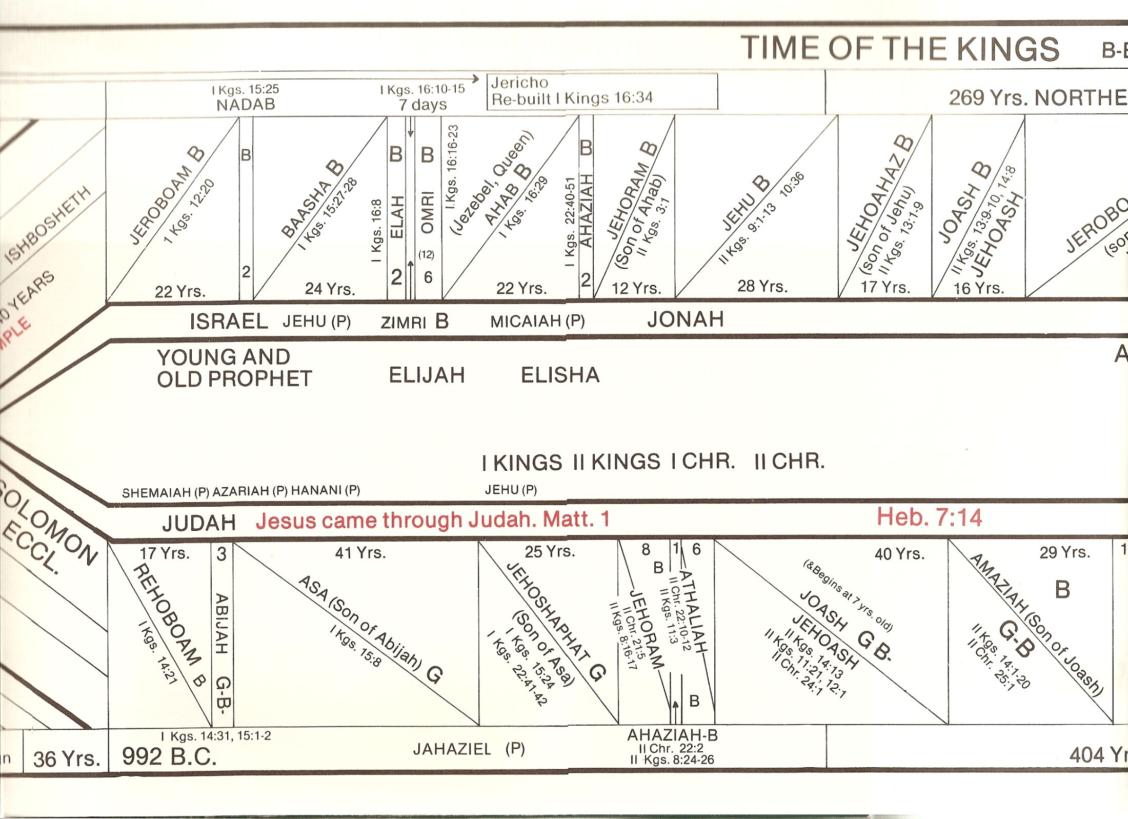

Slide 18
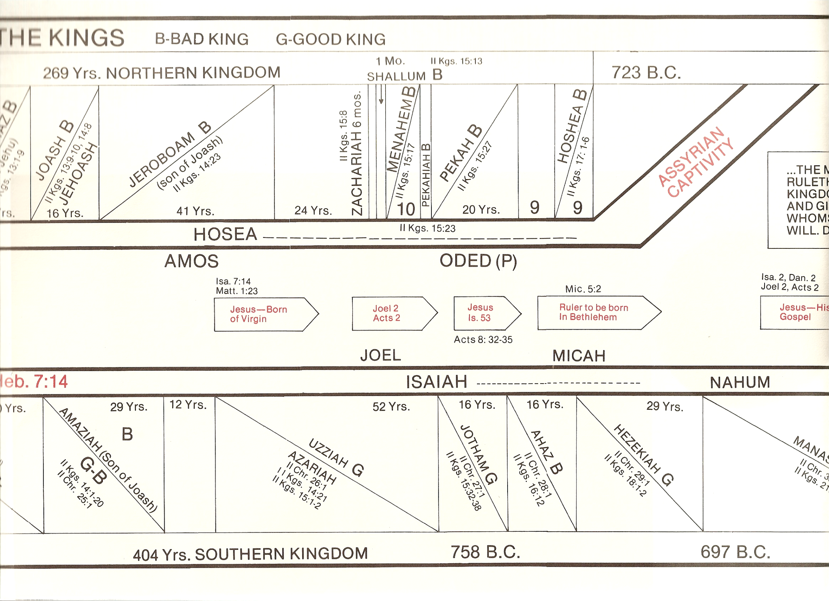

Slide 19
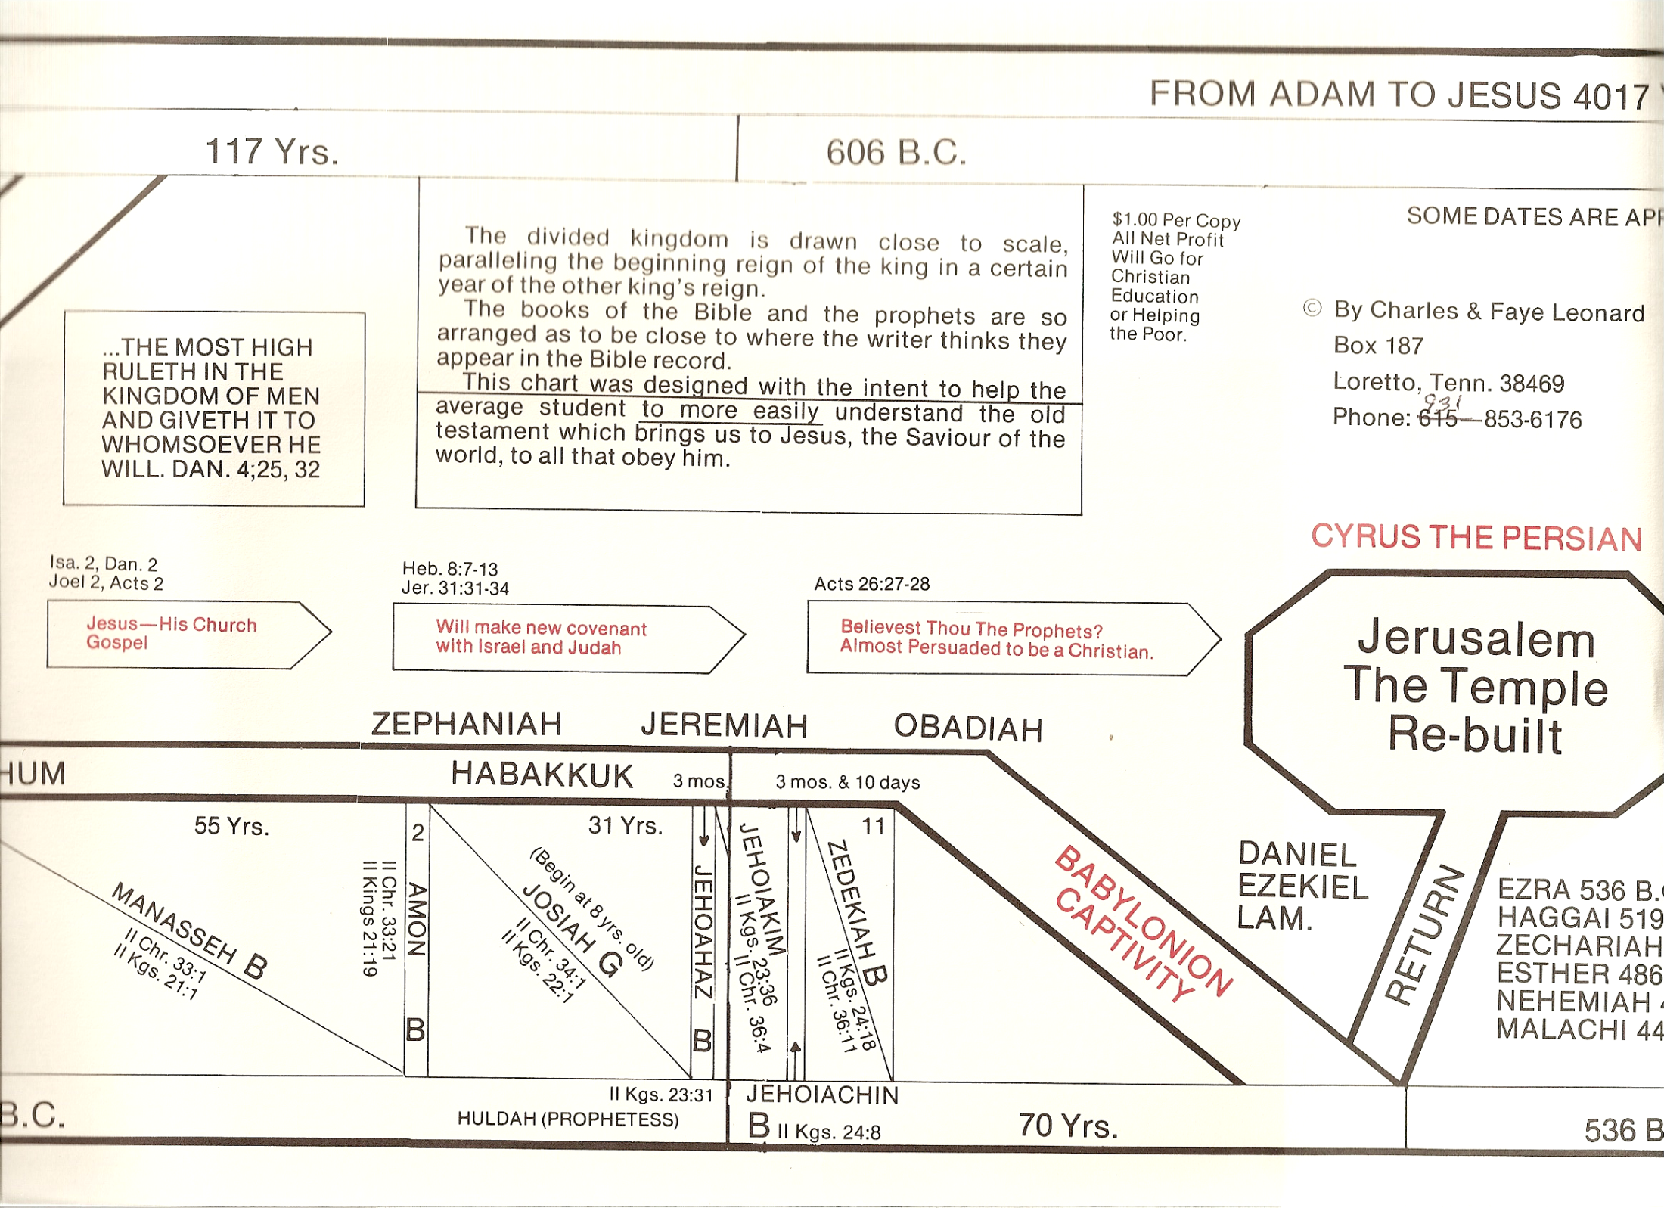

Slide 20
My Servants
The Prophets
Terms Used for the Prophets
Work of the Prophets
Schools of the Prophets

Slide 21
Schools of the Prophets
Common idea: school trained men to be prophets
“School of prophets” never used in Bible
References to what seems to be “school of the prophets”
  2 Kings 4:38 – “sons of the prophets”
  2 Kings 5:22 – “sons of the prophets”
  2 Kings 6:1-7 – “sons of the prophets” dwell with prophet
  1 Sam. 10:9-12 – company of prophets
  1 Sam. 19:18-23 – Group of prophets - prophesying
May have been groups come and learn from prophets
They may have gone forth and taught what they learned

Slide 22
Schools of the Prophets
Common idea: school trained men to be prophets
“School of prophets” never used in Bible
References to what seems to be “school of the prophets”
No evidence of a school – trained men to be prophets
  Any who were taught would not have been inspired
  God called, chose prophets (i.e. Isa. 6)

Slide 23
My Servants
The Prophets
Terms Used for the Prophets
Work of the Prophets
Schools of the Prophets
Classifying the Prophets

Slide 24
Classifying the Prophets
By arrangement in the text

Slide 25
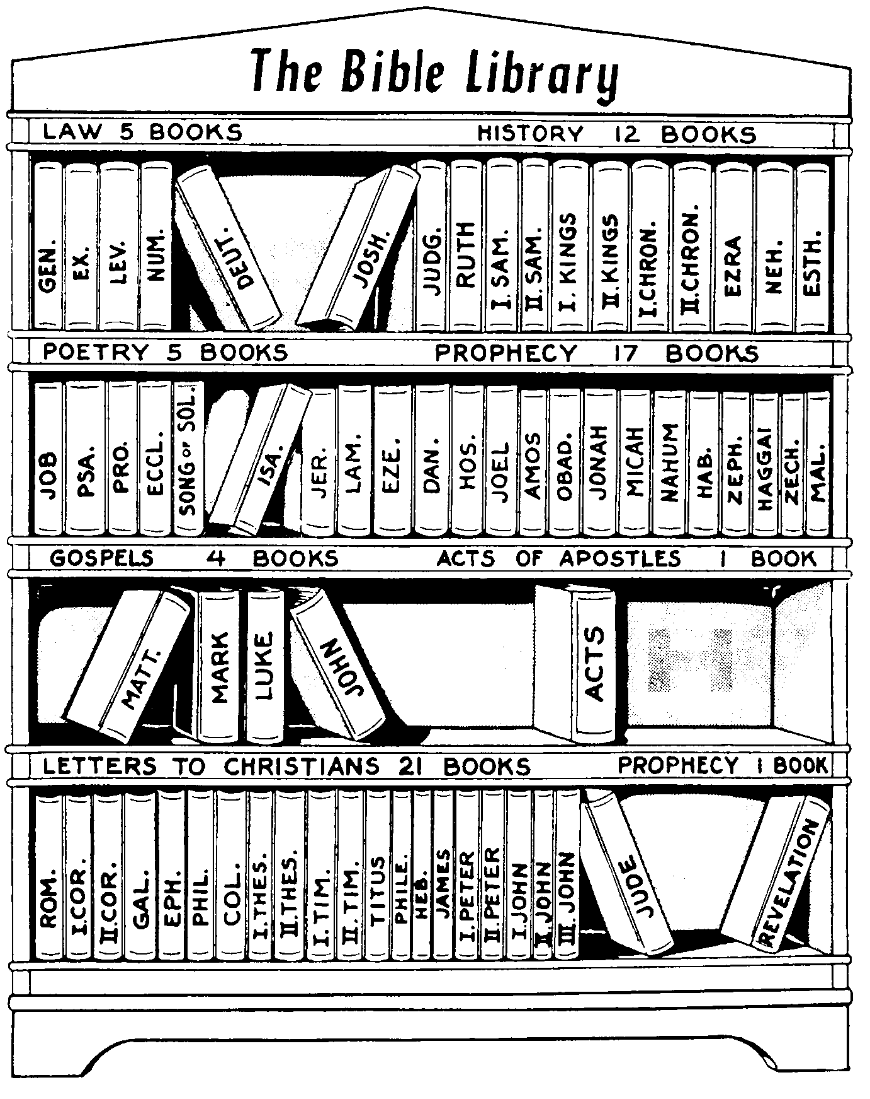

Slide 26
Classifying the Prophets
By arrangement in the text
  Major prophets (Larger in size) – 5 books
  Minor prophets (Smaller in size) – 12 books

Slide 27
Classifying the Prophets
By arrangement in the text
By chronology
  Pre-Exile Prophets (Isaiah, Hosea, Micah, etc..)
  Exile Prophets (Daniel, Ezekiel)
  Post-Exile Prophets (Haggai, Zechariah, Malachi)

Slide 28
Classifying the Prophets
By arrangement in the text
By chronology
By Recipient / Nation to whom preached
  Israel (north) – Hosea, Amos
  Judah (south) – Joel, Isaiah, Micah, Zeph., Jeremiah
  Exiles – Ezekiel, Daniel
  Remnant – returned – Haggai, Zech. Mal.

Slide 29
Classifying the Prophets
By arrangement in the text
By chronology
By Recipient / Nation to whom preached
By Dominant Empire at time
  Assyria period: Obadiah, Joel, Jonah, Hosea, Amos, Isaiah, Micah, Nahum
  Babylonian period: Zeph, Jeremiah, Hab., Daniel, Ezekiel
  Persian period: Haggai, Zech, Malachi

Slide 30
My Servants
The Prophets
Terms Used for the Prophets
Work of the Prophets
Schools of the Prophets
Classifying the Prophets
Dating the Prophets

Slide 31
Prophet | Nation Prophesied | Date
Obadiah | Edom | 846 (586) BC
Joel | Judah (South) | 837-800 BC
Jonah | Nineveh | 825-782 BC
Amos | Israel (North) | 810-785 (760) BC
Hosea | Israel (North) | 782-725 BC
Isaiah | Judah (South) | 739-690 BC
Micah | Judah (South) | 735-700 BC
Nahum | Judah (South) Nineveh | 663-612 BC
Zepheniah | Judah (South) | 630-625 BC
Jeremiah | Judah (South) | 625-586 BC
Habakkuk | Judah (South) | 612-606 BC
Daniel | Babylon | 606-534 BC
Ezekiel | Exiles in Babylon | 597-586 BC
Haggai | Remnant Returned | 520 BC
Zechariah | Remnant Returned | 520-518 BC
Malachi | Remnant Returned | 445-432 BC

Slide 32
My Servants
The Prophets
Terms Used for the Prophets
Work of the Prophets
Schools of the Prophets
Classifying the Prophets
Dating the Prophets

Slide 33
Things to Watch For in the Prophets
Prevailing Conditions (Political / Spiritual)
God & Nations
Messianic Hope

