Slide 1
Our Character
Review
Honesty
What Is Honesty?
Is It In Your Character?
How Do I Apply It?
How Do I Instill It?

Slide 2
Our Character
Review
Humility
What Is Humility?
What Is Humility?
An Example of Humility
An Example of Humility
The Demand for Humility
The Demand for Humility
The Effect of Humility
The Effect of Humility

Slide 3
Review
Our Character:
Sincerity
Hypocrite Can’t See
Hypocrite Can’t See
Hypocrite Has Trouble
Hypocrite Has Trouble
Hypocrite Affects Others
Hypocrite Affects Others

Slide 4
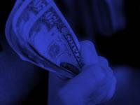

Our Character:
Contentment
1. Not always easy to be content
2. Many situations and opportunities to be discontent
3. Problem for the rich, the poor & all between
4. Seldom confessed sin

Slide 5
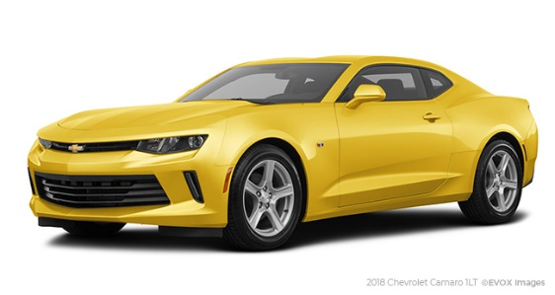
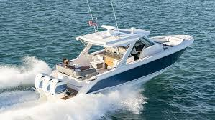
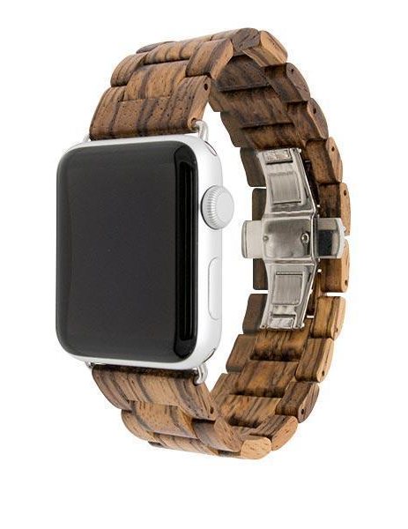
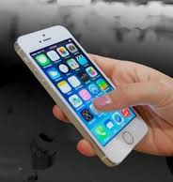
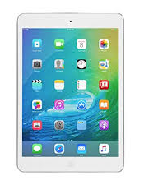
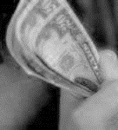

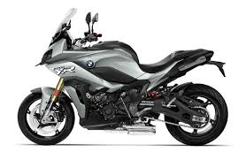
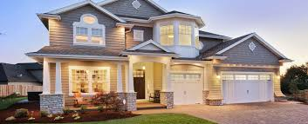
All will admit that materialism is a problem
Few admit – they are materially minded
Can’t live without money & material things
Thus, easy to misplace our emphasis!

Slide 6
Relative Terms
A Matter Of Perspective
Wealth
Rich
Expensive
Cheap
Luxury
Debt

Slide 7
Wealth: Good & Bad
Rich – Yet Faithful
Abraham (Gen. 13:2)
Job (Job 1:3, 8)
Joseph (Matt. 27:57)
John (John 19:27)
Rich – Condemned
Loved money (Matt. 19:16-22)
Covetous (Lk 12:12-21)
Selfish (Lk 16:19-31)
Trust in riches (Rev 3:16-17)

Slide 8
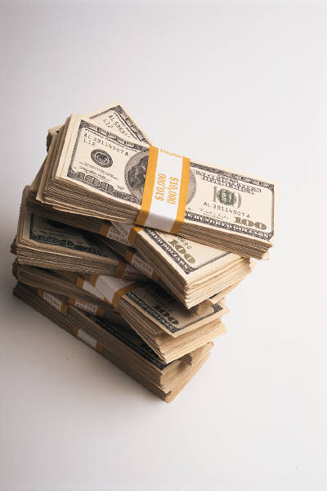
Prov. 13:7
There is one who makes himself rich, yet has nothing;
And one who makes himself poor, yet has great riches.
Some who have money
act like they are poor.
Some who have little
act as if they have money

Slide 9
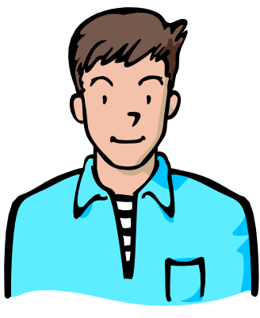

Materially Minded
Wealthy
Not
Material Minded
P
O
S
S
I
B
L
E
Poor
Is
Material Minded

Slide 10
Three Passages
Phil. 4:11
Not that I speak in regard to need, for I have learned in whatever state I am, to be content:

Slide 11
Three Passages
1 Tim. 6:8
And having food and clothing, with these we shall be content.

Slide 12
Three Passages
Heb. 13:5
Let your conduct be without covetousness; be content with such things as you have. For He Himself has said, "I will never leave you nor forsake you."

Slide 13
Our Character:
Contentment
Contentment Defined
Contentment Defined

Slide 14
1. Word used (1 Tim. 6:8; Heb. 13:5) – ARKEO
  “primarily signifies ‘to be sufficient, to be possessed of sufficient strength, to be strong, to be enough for a thing’; hence, ‘to defend, ward off’; in the middle voice, ‘to be satisfied, contented with,’” (Vines)
  Translated: “Enough” (Matt. 25:9); “Sufficient” (2 Cor. 12:9)
  Used in Luke 3:14 – satisfied with wages
2. Word used (Phil. 4:11) – AUTARKES
  “(autos, ‘self,’ arkeo, ‘see’ A), ‘self-sufficient, adequate, needing no assistance’” (Vines)
  Idea of self-sufficient – I don’t need any more
Contentment Defined
Satisfied, Sufficient, Enough

Slide 15
Contrasted with Covetousness
(Heb. 13:5)
Contentment Defined

Slide 16
1 Tim. 6:6-10
6. But godliness with contentment is great gain.
7. For we brought nothing into this world, and it is certain that we can carry nothing out.
8. And having food and clothing, with these we shall be content.
9. But those who desire to be rich fall into temptation and a snare, and into many foolish and harmful lust which drown men into destruction and perdition.
10. For the love of money is the root of all kinds of evil, for which some have strayed from the faith in their greediness, and pierced themselves through with many sorrows.

Slide 17
Inordinate Desire For Wealth or Possessions
“Covetous”
(Luke 16:14)
Filarguros
# 5366
“Love of money”
(1 Tim. 6:10)
Filarguria
# 5365
“Covetous”
(2 Tim. 3:2)
Filarguros
# 5366

Slide 18
“..contentment always goes together with true godliness, …”
Lenksi, 705
Contentment Defined

Slide 19
“The secret of contentment is knowing how to enjoy what you have and be able to lose all desire for things beyond your reach.”
- unknown
Contentment Defined

Slide 20
(Misunderstandings)
“Not to be confused with complacency in the illusion of sufficiency” (Kittle on Rev. 3:17)
Not apathetic indifference
Can be content if have what I want. “I would be happy if…”
Inborn nature - Not a command
Means can’t work toward better income, house, etc.
Contentment Defined

Slide 21
Our Character:
Contentment
Contentment Defined
Contentment Defined
Passages In Context
Passages In Context

Slide 22
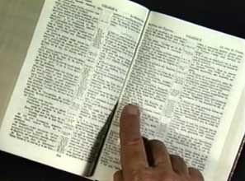
Phil. 4:11-13
Chapter – Various exhortations
Verse 10-20 Thanks for gift (support)
  Has flourished after hindered (v. 10)
  Could be content –not merely joyous for material things (vv. 11-13, 17)
  Done well in support (vv. 14-16)
  I abound with your gifts (v. 18)
Passages in Context

Slide 23
1 Tim. 6:6-8
Chapter – warns about false teachers, riches, etc
Verse 6-8 Content – vs - Riches
  Content (vv. 6-8)
  Riches (vv. 9-10)
Warning about riches (vv. 17-19)
Passages in Context

Slide 24
Heb. 13:5
Chapter – Personal responsibility (love, hospitality, marriage, submit to elders, etc.)
Contentment – vs – Covetousness (vv. 5-6)
Passages in Context

Slide 25
Phil. 4:11-13
1 Tim. 6:6-8
Heb. 13:5
Context – material riches, money,
Not: satisfied with spiritual status
Passages in Context

Slide 26
Our Character:
Contentment
Contentment Defined
Contentment Defined
Passages In Context
Passages In Context
Lessons Learned
Lessons Learned

Slide 27
1. Must be Learned
Phil. 4:11
Not automatically
Not that some have it – some don’t
Not just “nature”
Must cultivate it – develop it – work at it
May be a real struggle
Lessons Learned

Slide 28
1. Must be Learned
2. Extent to be content
In whatever state (Phil. 4:11)
Having food and clothing (1 Tim 6:6-8)
With such things as have (Heb. 13:5)
Not to worry about material things (Matt. 6:24-ff)
Lessons Learned

Slide 29
1. Must be Learned
2. Extent to be content
3. How
Realize nothing is ours (1 Tim. 6:7)
Follow example of Paul (Phil. 4:11-12)
  Learned to be abased (2 Cor. 4:8-10; 6:4-5; 11:25-27)
  To abound (v. 18)
With help of Christ (Phil 4:13)
Realize spiritual relationship most important (Heb. 13:5)
Lessons Learned

Slide 30
1. Must be Learned
2. Extent to be content
3. How
4. Reason Not Content: Covetous
Lessons Learned

Slide 31
4. Reason Not Content: Covetous
Heb. 13:5
Covetous: “Eager for more and more” (Vines)
Love for material world (1 Tim. 6:6-8)
“Without covetousness” – “free from love of money” (Vines)
Problem: Too attached to material world
  Think: “If only I had….I would be happy”
  Money
  Material things (house, cars, clothes, electronics, etc)
Lessons Learned

Slide 32
1. Must be Learned
2. Extent to be content
3. How
4. Reason Not Content: Covetous
Lessons Learned
5. Real Gain

Slide 33
5. Real Gain
1 Tim. 6:6
Real gain – not money or material things
Righteousness – living right
Right priorities
Focus on spiritual (Heb. 13:5-6) “he said”
Prov. 16:8
“To be without some of the things you want is an indispensable part of happiness” (Bertrand Russell)
Lessons Learned

Slide 34
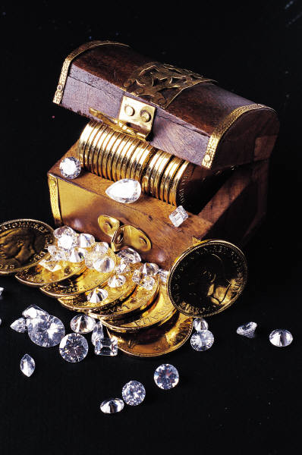
Things Worth More Than Riches & Money
Wisdom (Prov. 3:13-20)
Fear (Prov. 15:16)
Righteousness (Prov. 16:8)
Integrity (Prov. 19:1)
Good Name (Prov. 22:1)
Soul (Matt. 16:26)

Slide 35
Things We See
Money
Cars
Furniture
Houses
Clothes
Televisions
Computers
Jewelry
Pictures
Things We Can’t See
God
Soul
Heaven
Hope
Faith
Love
Grace
Peace

Slide 36
Our Character:
Contentment
Contentment Defined
Contentment Defined
Passages In Context
Passages In Context
Lessons Learned
Lessons Learned

Slide 37
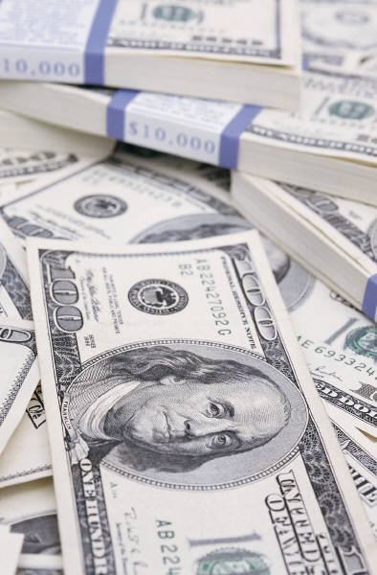
Is money the main thing / first thing I think about?
Do I think more about material things than spiritual things?
Do I measure people by material possessions?
Am I frustrated because I have less than others?
Work harder to have material than I do spiritual?
Questions

