Slide 1
Our Character
Review
Honesty
What Is Honesty?
Is It In Your Character?
How Do I Apply It?
How Do I Instill It?

Slide 2
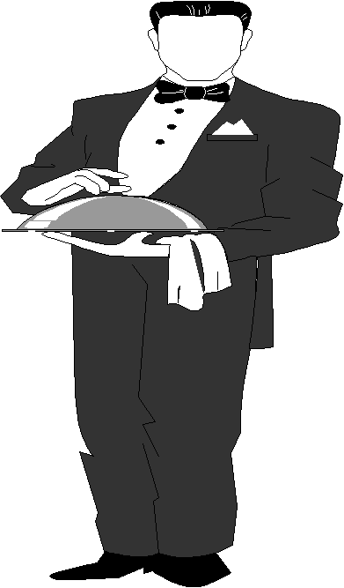
Our Character
Humility
2 Tim 2:24-25
And a servant of the Lord must not quarrel but be gentle to all, able to teach, patient, in humility correcting those who are in opposition, if God perhaps will grant them repentance, so that they may know the truth,
God’s people are servants
Humble servants

Slide 3
Our Character
Humility
What Is Humility?
What Is Humility?

Slide 4
A. The English Word
What Is Humility?

Slide 5
Humble
adj. hum·bler, hum·blest
Marked by meekness or modesty in behavior, attitude, or spirit; not arrogant or prideful.
Showing deferential or submissive respect: a humble apology.
Low in rank, quality, or station; unpretentious or lowly: a humble cottage.
tr.v. hum·bled, hum·bling, hum·bles
To curtail or destroy the pride of; humiliate.
To cause to be meek or modest in spirit.
To give a lower condition or station to; abase.
[Middle English, from Old French, from Latin humilis, low, lowly, from humus, ground. See dhghem- in Indo-European Roots.]
www.dictionary.com

Slide 6
The English Word
The Greek Word
What Is Humility?

Slide 7
Humble - tapeinos
NT:5011
tapeinos (tap-i-nos'); of uncertain derivation; depressed, i.e. (figuratively) humiliated (in circumstances or disposition):
KJV - base, cast down, humble, of low degree (estate), lowly.
(Strong’s)

Slide 8
Humble - tapeinos
HUMBLE (ADJECTIVE AND VERB)
1. tapeinos NT:5011 primarily signifies "low-lying." It is used always in a good sense in the NT, metaphorically, to denote (a) "of low degree, brought low," Luke 1:52; Rom 12:16, KJV, "(men) of low estate," RV, "(things that are) lowly" (i. e., of low degree); 2 Cor 7:6, KJV, "cast down," RV, "lowly"; the preceding context shows that this occurrence belongs to (a); James 1:9, "of low degree"; (b) humble in spirit, Matt 11:29; 2 Cor 10:1, RV, "lowly," KJV "base"; James 4:6; 1 Peter 5:5. See BASE, CAST, Note (7), DEGREE (Note), LOWLY.
(Vines)

Slide 9
Humility - tapeinophrosune
HUMBLENESS OF MIND, HUMILITY
tapeinophrosune NT:5012, "lowliness of mind" (tapeinos, see A, above, under HUMBLE, and phren, "the mind"), is rendered "humility of mind" in Acts 20:19, KJV (RV, "lowliness of mind"); in Eph 4:2, "lowliness"; in Phil 2:3, "lowliness of mind"; in Col 2:18,23, of a false "humility"; in Col 3:12, KJV, "humbleness of mind," RV, "humility"; 1 Peter 5:5, "humility." See LOWLINESS.
(Vines)

Slide 10
Humble - tapeinos
NT:5011
tapeinos, tapeinee tapeinon,
low,
a. properly, not rising far from the ground:
b. metaphorically,
a. as to condition, lowly, of low degree:
b. lowly in spirit, humble:
(Thayer's Greek Lexicon)

Slide 11
Humble - tapeinos
# 5011 (KJV)
“lowly” - Matt. 11:29
“low degree” – Luke 1:52
“low estate “ – Rom. 12:16
“humble” (NKJV) – Rom. 12:16
“cast down” – 2 Cor. 7:6
“base” – 2 Cor. 10:1
“low degree” – Jas. 4:6
“humble” – 1 Pet. 5:5

Slide 12
The English Word
The Greek Word
Synonyms / Antonyms
What Is Humility?

Slide 13
Synonyms
Antonyms
Lowly
Abase
Cast down
Unassuming
Unpretentious
Unassertive
Meek
Arrogant
Proud
Defiant
Lofty
Haughty
Overbearing
Snobbish

Slide 14
Our Character
Humility
What Is Humility?
What Is Humility?
An Example of Humility
An Example of Humility

Slide 15
A. Matt. 11:29 – Meek & lowly in heart
“Humble in heart” (NASV; NIV)
Context of the Lord’s invitation
Given as a reason why one should be attracted & come
He is not harsh, overbearing or oppressive
One can easily obey him
An Example of Humility

Slide 16
A. Matt. 11:29 – Meek & lowly in heart
B. Phil. 2:5-11 – Humbled – willing to die
Context humility essential to unity (vv. 1-4)
Urged to have the same mind (v. 5)
An Example of Humility

Slide 17
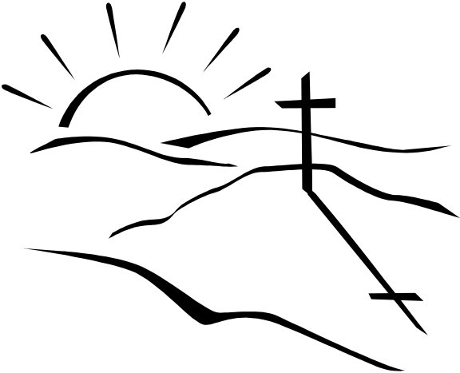
The Humility of Jesus
(Phil. 2)
Who He Is
What He Did
Equal with God
Form of God
Became Man
Form of Servant
Obed. to cross
Yet

Slide 18
A. Matt. 11:29 – Meek & lowly in heart
B. Phil. 2:5-11 – Humbled – willing to die
C. John 13:1-17 – Washed disciples’ feet
An Example of Humility

Slide 19
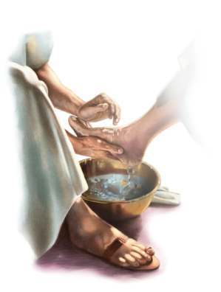
Jesus Washed Disciples Feet
Done with awareness of his exalted position (v. 3)
Girded self with towel – dressed like a servant (v. 4)
Act of a servant (v. 5)
Purpose – show his work served humanity (v. 8)
Lesson – we might humbly serve others (vv. 12-17)

Slide 20
Our Character
Humility
What Is Humility?
What Is Humility?
An Example of Humility
An Example of Humility
The Demand for Humility
The Demand for Humility

Slide 21
Micah 6:8 – Lord requires… to walk humbly with God
Matt. 18:4 – humbles himself as child is greatest
Rom. 12:3 – not think more highly than ought to think
Rom. 12:16 – do not mind high things – associate….
Col. 3:12 – put on humility
Tit. 3:2 – showing all humility toward all men
Jas. 4:6, 10 – humble self in sight of Lord
1 Pet. 5:5-6 – humble self under mighty hand of God
The Demand for Humility

Slide 22
Our Character
Humility
What Is Humility?
What Is Humility?
An Example of Humility
An Example of Humility
The Demand for Humility
The Demand for Humility
The Effect of Humility
The Effect of Humility

Slide 23
When Dealing With Those Who Are “Less” (Rom. 12:16)
When Teaching (2 Tim. 2:25)
When Dealing With Brethren (1 Pet. 3:8)
The Effect of Humility
When Dealing With Opposition (2 Tim. 2:25)
When We Excel or Are Strong (Rom. 12:3)
When Striving For Unity & Harmony (Phil. 2:1-4)

Slide 24
Unity & Harmony
Phil. 2:1-4
{
Phil. 1:27 – Stand fast in one Spirit
With one mind
Striving together
1. Plea
Phil. 2:2 – one accord & one mind
{
Consolation in Christ
Comfort of love
Fellowship of Spirit
Affection of mercy
2. Basis
Since (v. 1)
3. Attitude
Humility (vv. 3-4)

Slide 25
Contrast in Phil. 2:3-4
Selfish
Ambition (v. 3)
Conceit (v. 3)
Look at own
interest (v. 4)
Lowliness
of mind (v. 3)
Esteem
Others (v. 3)
Look at others’
interest (v. 4)

Slide 26
Ephesians 4:1-3
1 I, therefore, the prisoner of the Lord, beseech you to walk worthy of the calling with which you were called,
2 with all lowliness and gentleness, with longsuffering, bearing with one another in love,
3 endeavoring to keep the unity of the Spirit in the bond of peace.

Slide 27
Our Character
Humility
What Is Humility?
What Is Humility?
An Example of Humility
An Example of Humility
The Demand for Humility
The Demand for Humility
The Effect of Humility
The Effect of Humility

