Slide 1
Our Character
Honesty
Is praised by all – even those dishonest
“Honesty is the best policy”
“Thank you for being honest”
“I am going to be honest with you…”
“I am not going to lie to you”
“At least she is being honest”

Slide 2
Our Character
Honesty
Surrounded by so much dishonesty
Lying – Misrepresentation
Cheating – Corruption – Broken promises
Cover-up – Stealing – Embezzlement
Misleading – Take advantage

Slide 3
Our Character
Honesty
Not just a commendable thing to do
Not just something occasionally use
But developed as a part of - Character

Slide 4
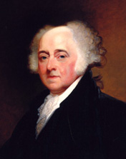
Honesty
President John Adams
(First to live in The White House)
“I pray heaven bestow the best of blessings on this house and on all that shall hereafter inhabit it. May none but honest and wise men ever rule under this roof”
(Kate Waters, The Story of The White House, p. 2, Scholastic, INC New York 1991)

Slide 5
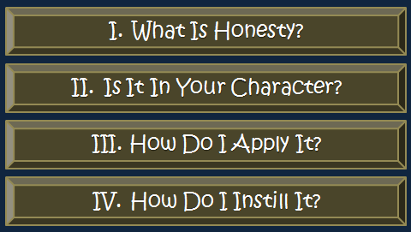
Our Character
Honesty
4
?

Slide 6
Honesty
What Is Honesty?
What Is Honesty?

Slide 7
“Honest”
  “1. Marked by or displaying truthfulness and integrity; upright. 2. Not deceptive or fradulent; genuine: honest weight. 3. Equitable; fair: honest wages for an honest days work. 4. Characterized by integrity and truth; not false: honest reporting…” (AHD)
  “1. honorable in principles, intentions, and actions; upright and fair: an honest person. 2. showing uprightness and fairness: honest dealings. 3. gained or obtained fairly: honest wealth. 4. sincere; frank: an honest face. 5. genuine or unadulterated: honest commodities. 6. respectable; having a good reputation: an honest name. 7. truthful or creditable: honest weights. 8. humble, plain, or unadorned. 9. Archaic. chaste; virtuous.” (dictionary.com)
What Is Honesty?

Slide 8
“Honest”
“Integrity”
  “1 the quality of being honest and morally upright. 2 the state of being whole or unified. 3 soundness of construction” (Compact Oxford)
  “Etymology: Middle English integrite, from Middle French & Latin; Middle French integrité, from Latin integritat-, integritas, from integr-, integer entire. Date: 14th century 1 : firm adherence to a code of especially moral or artistic values : incorruptibility
  2 : an unimpaired condition : soundness
  3 : the quality or state of being complete or undivided : completeness. synonyms see honesty” (Merriam – Webster)
What Is Honesty?

Slide 9
“Honest”
“Integrity”
Greek words
  1. kalos NT:2570, "good, admirable, becoming," has also the ethical meaning of what is "fair, right, honorable, of such conduct as deserves esteem"; it is translated "honest" [cf. Latin honestus (from honos, "honor")], which has the same double meaning as "honest" in the KJV, namely, regarded with honor, honorable, and bringing honor, becoming; in Luke 8:15 (KJV, and RV), "an honest and good (agathos) heart"; Rom 12:17; 2 Cor 8:21 and 13:7, RV, "honorable" (KJV, "honest"), of things which are regarded with esteem; in 1 Peter 2:12, of behavior, RV, "seemly," KJV, "honest" (i. e., becoming). See GOOD.
  2. semnos NT:4586, "august, venerable," is rendered "honest" in Phil 4:8, KJV (marg., "venerable"), RV, "honorable" (marg., "reverent"). Matthew Arnold suggests "nobly serious." See GRAVE. Note: In Acts 6:3, "men of honest (RV, 'good') report" translates the passive voice of martureo, lit., "having had witness borne.“ (Vines)
What Is Honesty?

Slide 10
“Honest”
“Integrity”
Greek words
Summary:
Honorable
Truthful
Genuine
Fair
Credible
Integrity
What Is Honesty?

Slide 11
“Integrity is telling myself the truth. And honesty is telling the truth to other people” (Spencer Johnson).
“Honesty is the first chapter in the book of wisdom” (Thomas Jefferson).
“No legacy is so rich as honesty” (William Shakespeare).
“Honesty is the cornerstone of all success, without which confidence and ability to perform shall cease to exist” (Mary Kay Ash).
Quotes

Slide 12
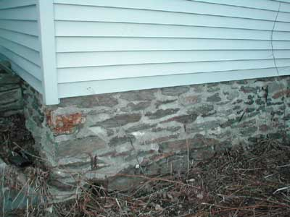
Honesty is the backbone or foundation of all relationships – in all areas of life.
“Honesty is like an icicle; if once it melts that is the end of it” (American Proverb).
Quotes
Relationships
Honesty

Slide 13
Honesty is the backbone or foundation of all relationships – in all areas of life.
“Honesty is like an icicle; if once it melts that is the end of it” (American Proverb).
“Integrity is doing right when no one is looking.”
Quotes

Slide 14
Honesty
What Is Honesty?
Is It In Your Character?
Is It In Your Character?

Slide 15

Rooted in Your Character
  Not merely:
    Something have to prove
    Something that parade – to help some situation
    Occasionally use – for your advantage
  Character
    Part of what makes you what you are
    In your character
    One of your attributes
    Part of your nature
    In your temperament
Is It In Your Character?

Slide 16
Rooted in Your Character
Is Part of the Christian Character
  Live a life of honest (1 Tim. 2:2)
  Do things honest (Rom. 12:17; 2 Cor. 8:21)
  Manner of life is to be honest (1 Pet. 2:12)
  Honest even if others are not (2 Cor. 13:7; Rom. 12:17)
  Integrity better than riches (Prov. 19:1)
Is It In Your Character?

Slide 17
Rooted in Your Character
Is Part of the Christian Character
Benefits of Honesty
  Content (Heb. 13:5)
  Quiet and peaceable life (1 Tim. 2:2)
  Trusted with responsibility (Acts 6:3)
  Good conscience (Heb. 13:18)
Is It In Your Character?

Slide 18
Honesty
What Is Honesty?
Is It In Your Character?
How Do I Apply It?
How Do I Apply It?

Slide 19
Be Honest With Yourself
  Possible to deceive self (1 Cor. 3:18; 1 Jno. 1:8)
  Seek to protect self from reality.
  Make a bad situation “better” for the moment
  Refuse to accept the truth
  Refuse to accept some situation
  Refuse to acknowledge error, mistake or sin
How Do I Apply It?

Slide 20
Be Honest With Yourself
Tell the Truth – Don’t Lie
  Put away lying – speak the truth (Eph. 4:25; Col. 3:9)
  The truth may not always be easy to tell
  Don’t craft words – with intent to mislead
    Selling a product
    Telling what you have done
    Reporting what others have done
How Do I Apply It?

Slide 21
Be Honest With Yourself
Tell the Truth – Don’t Lie
Do What You Promise
  Careful of vows – because of the obligation (Ecc. 5:4-5; Deut. 23:21-22)
  Don’t make rash promises (Prov. 20:25)
  Do what you say you will!
    If you say be somewhere – at certain time – BE THERE!
    If accept dinner invitation – GO!
    If offer to pay for something – PAY!
    If you give a price – HONOR IT!
    If you make plans – KEEP THEM!
    If you say you will do a task – DO IT!
How Do I Apply It?

Slide 22
Be Honest With Yourself
Tell the Truth – Don’t Lie
Do What You Promise
Don’t Flatter
  No one appreciates flatter (Prov. 28:23; 29:5)
  Don’t give praise or compliment that is not genuine
  Don’t exaggerate or falsely commend
How Do I Apply It?

Slide 23
Be Honest With Yourself
Tell the Truth – Don’t Lie
Do What You Promise
Don’t Flatter
Make Your Word Mean Something
  Your “yes” should means “yes”, etc. (Matt. 5:33-37; Jas. 5:12)
  Shameful when said about Christians:
    “I wouldn’t put much stock in what he/she says.”
    “You can’t depend on him/her – do what say.”
    “I wouldn’t believe it just because he said it.”
    “I’ll believe that he will do that – when I see it.”
    “You had better get that in writing…”
How Do I Apply It?

Slide 24
Be Honest With Yourself
Tell the Truth – Don’t Lie
Do What You Promise
Don’t Flatter
Make Your Word Mean Something
Pay What You Owe
  Taxes (Rom. 13:1-7)
  Debts (Rom. 13:8; Eph. 4:28)
How Do I Apply It?
Practice Honesty
So that it becomes our habit & nature
Don’t think twice about what we say or do

Slide 25
Honesty
What Is Honesty?
Is It In Your Character?
How Do I Apply It?
How Do I Instill It?
How Do I Instill It?

Slide 26

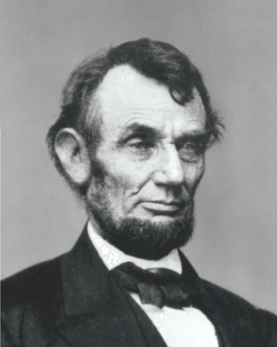
Be An Example
  Children learn by what they see (Ezek. 16:44)
  They know when you are being honest
  Need to see you honest in the smallest of areas
    Go to great lengths to be fair and honest!
How Do I Instill It?
“Honest Abe”
Walked several miles to return a few cents that he had accidently overcharged a customer.

Slide 27
Be An Example
  Children learn by what they see (Ezek. 16:44)
  They know when you are being honest
  Need to see you honest in the smallest of areas
  See you being fair to others
    Give the benefit of the doubt
    Want to treat even enemy fairly
    As fair with others as your own friends / family
How Do I Instill It?
Jewish Proverb:
“What you don’t see with your eyes,
don’t witness with your mouth.”

Slide 28
Be An Example
  Children learn by what they see (Ezek. 16:44)
  They know when you are being honest
  Need to see you honest in the smallest of areas
  See you being fair to others
  Keep your promises to them!
    Be where you say you will be!
    Do what promise to do!
    Take them where you promised to take them!
    Play what you promised to play!
How Do I Instill It?

Slide 29
Be An Example
Praise / Commend Honesty
  Part of training (Prov. 22:6)
  Even when punishment is due
  Make the honesty work to their benefit
How Do I Instill It?

Slide 30
Be An Example
Praise / Commend Honesty
Correct / Punish Dishonesty
  Part of training (Prov. 22:6)
  Punishment due for foolish action (Prov. 22:15)
  Make lying a heinous crime in your house!
How Do I Instill It?

Slide 31
Be An Example
Praise / Commend Honesty
Correct / Punish Dishonesty
Look for “Teachable” Moments
  Part of training (Prov. 22:6)
  When others have lied
  When others have shaded the truth
  When others mislead with “true” statements
  When others didn’t keep their word
  When some are incredibly honest!
How Do I Instill It?

Slide 32
Be An Example
Praise / Commend Honesty
Correct / Punish Dishonesty
Look for “Teachable” Moments
Reverse the Situations
  How would you want others to treat you (Matt. 7:12)?
  Would you want others to lie to you?
  Would you want others to mislead you with “true statements”?
  Would you want others to treat you fairly?
  Would you want others to keep their word?
  Would you want others to keep their commitments?
  Would you want others to take advantage of you?
How Do I Instill It?

Slide 33
Honesty
What Is Honesty?
Is It In Your Character?
How Do I Apply It?
How Do I Instill It?

Slide 34

Honesty Test Question
“What would a person who is incredibly honest do in this situation?”

