Slide 2
No Christian is without relationships to others
Every Christian has an “attitude” toward others
  May be good & right
  May be bad & wrong
“Others” = Brethren, neighbors, or peers
Attitudes form the basis on how we treat them
  Matt. 15:19 – actions come from the heart
  Talk about, slander, avoid, ostracize, etc.

Slide 3
Our Attitude
Toward Others
I. Who – One Responsible for Right Attitude
II. What – Attitudes We Should Have
III. Why – Importance of the Right Attitude

Slide 4
Our Attitude
Toward Others
I. Who – One Responsible for Right Attitude
II. What – Attitudes We Should Have
III. Why – Importance of the Right Attitude

Slide 5
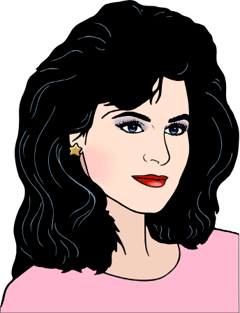
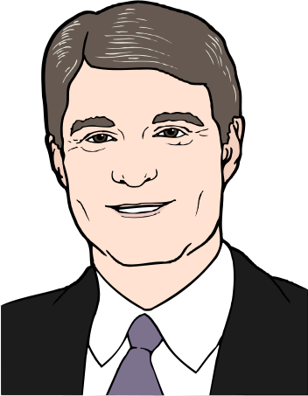
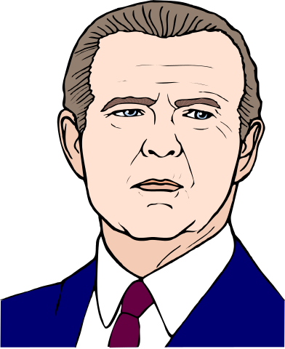
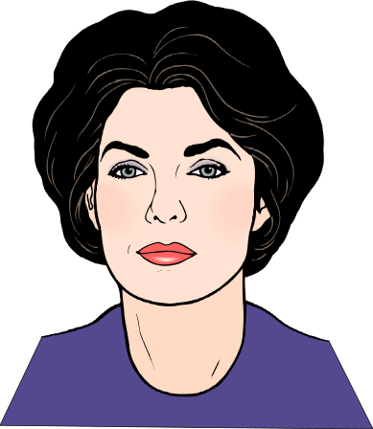
I. Who – One Responsible for Right Attitude
Common Problem:
Often think that others should have the right attitude toward us,
but do little thinking about whether we have the right attitude toward others

Slide 6
I. Who – One Responsible for Right Attitude
Rom 12:18
“If it is possible, as much as depends on you, live peaceably with all men.”
A. Do your part
1. Work hard toward a good relationship
2. Try – requires effort on your part
3. Make sure that no one can blame you
4. Required by any passage on relationships
5. May require a change in attitude

Slide 7
I. Who – One Responsible for Right Attitude
Rom 12:18
“If it is possible, as much as depends on you, live peaceably with all men.”
A. Do your part
B. Even if others don’t
1. Not say “as much as depends on them”
2. You are to see “if it is possible” to get along
3. We must take the “high road”

Slide 8
Our Attitude
Toward Others
I. Who – One Responsible for Right Attitude
II. What – Attitudes We Should Have
III. Why – Importance of the Right Attitude

Slide 9
II. What – Attitudes We Should Have
A. Show mercy (Matt. 7:1-11)
1. Deals with judging without mercy (v. 2; cf. Lk. 6:36ff)
2. Consider own faults – mercy we need (v. 5)
3. Consider how gracious / merciful God has been to us (vv. 6-11)

Slide 10
II. What – Attitudes We Should Have
A. Show mercy (Matt. 7:1-12)
B. Treat other way want to be (Matt. 7:12)

Slide 11
Way You Want To Be Treated
Matt. 7:12
Golden Rule Says: Treat others way you want to be treated
Means: “…we are as much obliged to them as they are to us” - Matthew Henry
Forces Us To Think About:
  Way I want to be treated
  Way I treat Others
  Compare the two
  More than how others treat me!

Slide 12
II. What – Attitudes We Should Have
A. Show mercy (Matt. 7:1-12)
B. Treat other way want to be (Matt. 7:12)
C. Be humble (Eph. 4:2)

Slide 13
Be Humble
Eph. 4:2
Lowliness - NKJV
Deep sense of our own smallness - unworthiness.
Preference to others - Phil. 2:3 (same word trans. “Humility”)
Takes humility to recognize and admit “I was wrong” (Luke 18:10-13)
Realize how good God has been to me when I was not worthy – so I need to be to others.

Slide 14
II. What – Attitudes We Should Have
A. Show mercy (Matt. 7:1-12)
B. Treat other way want to be (Matt. 7:12)
C. Be humble (Eph. 4:2)
D. Be meek (Eph. 4:2)

Slide 15
Be Meek
Eph. 4:2
Gentleness (NKJV)
How we receive injuries

Slide 16
Be Meek
Eph. 4:2
“Meekness relates to the manner in which we receive injuries. We are to bear them patiently, and not to retaliate, or seek revenge. The meaning here is, that we adorn the gospel when we show its power in enabling us to bear injuries without anger or a desire of revenge, or with a mild and forgiving spirit.” - Barnes

Slide 17
Be Meek
Eph. 4:2
Gentleness (NKJV)
How we receive injuries
Opposite of bitterness - resentment
Control of self - as we deal with others:
Kind - Control - Gentle - not harsh

Slide 18
II. What – Attitudes We Should Have
A. Show mercy (Matt. 7:1-12)
B. Treat other way want to be (Matt. 7:12)
C. Be humble (Eph. 4:2)
D. Be meek (Eph. 4:2)
E. Be longsuffering (Eph. 4:2)

Slide 19
Be Longsuffering
Eph. 4:2
Literally: Suffer Long
Patient - exercise restraint.
Suggest - Collision of opinions, differing

Slide 20
“No virtue, perhaps, is more frequently demanded in our intercourse with others. We do not go far with any fellow traveler on the journey of life before we find there is great occasion for its exercise. He has a temperament different from our own.”
- Barnes

Slide 21
“He has his own plans and purposes of life, and his own way and time of doing things. He may be naturally irritable, or he may have been so trained that his modes of speech and conduct differ much from ours.”
- Barnes

Slide 22
“We must indulge the friend that we love in the little peculiarities of saying and doing things which may be important to him, but which may be of little moment to us.”
- Barnes

Slide 23
Be Longsuffering
Eph. 4:2
Literally: Suffer Long
Patient - exercise restraint.
Suggest - Collision of opinions, differing
Time for tolerance
“taking whatever comes, putting up with one another in love” - BBE

Slide 24
II. What – Attitudes We Should Have
A. Show mercy (Matt. 7:1-12)
B. Treat other way want to be (Matt. 7:12)
C. Be humble (Eph. 4:2)
D. Be meek (Eph. 4:2)
E. Be longsuffering (Eph. 4:2)
F. Give benefit of the doubt (1 Cor. 13:7)

Slide 25
Give The Benefit Of Doubt
1 Cor. 13:7
“believe all things”
Pistis (believe) “appears to bear in Gal. v.22 the meaning of faith in men” (EGNT, II, 899-900).
“eager to believe the best” (Moffatt)

Slide 26
Give The Benefit Of Doubt
1 Cor. 13:7
Put best construction on matters
  “Is ever ready to believe the best of every person, and will credit no evil of any but on the most positive evidence...” A. Clarke
  Prov. 14:15
Don’t jump to conclusions
  All too often we fill in gaps that are not there
  Prov. 18:13, 17 – often more & another side
  Prov. 29:20

Slide 27
II. What – Attitudes We Should Have
A. Show mercy (Matt. 7:1-12)
B. Treat other way want to be (Matt. 7:12)
C. Be humble (Eph. 4:2)
D. Be meek (Eph. 4:2)
E. Be longsuffering (Eph. 4:2)
F. Give benefit of the doubt (1 Cor. 13:7)
G. Be forgiving / forgiving spirit (Mt. 6:14)

Slide 28
Forgiving / Forgiving Spirit
Forgive = Release / send away
  “Primarily ‘to send forth, send away’” (Vine)
  Used of debts, sin (God forgiving us), etc.
We must be forgiving
  Matt. 6:14-15
  Matt. 18:21-35
Forgiving spirit – want to forgive
  Matt. 18:15-17
  Gal. 6:1

Slide 29
II. What – Attitudes We Should Have
A. Show mercy (Matt. 7:1-12)
B. Treat other way want to be (Matt. 7:12)
C. Be humble (Eph. 4:2)
D. Be meek (Eph. 4:2)
E. Be longsuffering (Eph. 4:2)
F. Give benefit of the doubt (1 Cor. 13:7)
G. Be forgiving / forgiving spirit (Mt. 6:14)
H. Good to enemy (Rom. 12:17-21)

Slide 30
Good to Enemy
Don’t do harm toward enemy
  Not repay evil for evil (v. 17)
  Vengeance is God’s place (v. 19)
Overcome evil with good
  Reach out to him (v. 20)
  Heap coals of fire on his head (vv. 20-21)

Slide 31
II. What – Attitudes We Should Have
A. Show mercy (Matt. 7:1-12)
B. Treat other way want to be (Matt. 7:12)
C. Be humble (Eph. 4:2)
D. Be meek (Eph. 4:2)
E. Be longsuffering (Eph. 4:2)
F. Give benefit of the doubt (1 Cor. 13:7)
G. Be forgiving / forgiving spirit (Mt. 6:14)
H. Good to enemy (Rom. 12:17-21)
I. Consider self (Gal. 6:1)

Slide 32
Consider Self
Gal. 6:1
Consider how you want to be approached
Consider – might be you next time

Slide 33
II. What – Attitudes We Should Have
A. Show mercy (Matt. 7:1-12)
B. Treat other way want to be (Matt. 7:12)
C. Be humble (Eph. 4:2)
D. Be meek (Eph. 4:2)
E. Be longsuffering (Eph. 4:2)
F. Give benefit of the doubt (1 Cor. 13:7)
G. Be forgiving / forgiving spirit (Mt. 6:14)
H. Good to enemy (Rom. 12:17-21)
I. Consider self (Gal. 6:1)
J. Don’t completely mark others off

Slide 34
Don’t Completely Mark Others Off
Often – we “mark them off” for good
  Even if they change
  Never trust them again
  Never forget what they’ve done
God doesn’t do that
  David, Peter, Simon, etc.
  Us!
John Mark – Disappointed Paul – used Again
  Acts 15:36-41 – Paul lost confidence
  2Tim. 4:11; Col 4:10 – Paul regained confidence

Slide 35
Our Attitude
Toward Others
I. Who – One Responsible for Right Attitude
II. What – Attitudes We Should Have
III. Why – Importance of the Right Attitude

Slide 36
III. Why – Importance of the Right Attitude
A. To be right
1. Treat others right – so we will be right
2. Not because they are “right”

Slide 37
III. Why – Importance of the Right Attitude
A. To be right
B. Could appear strong while others seem to be soft & tolerant – yet be wrong
1. 2 Cor. 2:11 – hard on fornication – seems like really taking a stand – others “sweep under rug”
2. Maybe my “hard line” stand – is a tool of Satan
3. Examples:
- Sins – repents – yet hold them at arm’s length
- Don’t know what they done – but condemn anyway

Slide 38
III. Why – Importance of the Right Attitude
A. To be right
B. Could appear strong while others seem to be soft & tolerant – yet be wrong
C. Could “hate” others – not realize it
1. Hate = lack of love [not despise]
a. 1 John 3:15
b. Compare: Matt. 10:37 with Luke 14:26-27
2. If my attitude is not good – could be hating others

Slide 39
III. Why – Importance of the Right Attitude
A. To be right
B. Could appear strong while others seem to be soft & tolerant – yet be wrong
C. Could “hate” others – not realize it
D. Could lose soul
1. Can loose soul over attitudes (Gal. 5:19-21)
2. Many will lose their souls over attitudes! (2 Cor 12:20)

Slide 40
Our Attitude
Toward Others
I. Who – One Responsible for Right Attitude
II. What – Attitudes We Should Have
III. Why – Importance of the Right Attitude

